Slide 1

Funding Universal Health Care in the Commonwealth of Massachusetts
Co-authored by Auden Cote-L’Heureux and Gerald Friedman

Slide 2
Background on the Bill
S.860/H.1405 would introduce a single-payer healthcare option in Massachusetts, in which all residents of MA (and non-residents working at least 20 hours a week in the state) would by default have all necessary medical expenses paid by the state.
Instead of being paid for with copays, deductibles, and premiums, medical coverage will be paid through taxation.
The Bill would implement the Massachusetts Health Care Trust (hereafter MHCT or the Trust), a state-level body tasked with administering single-payer health insurance in MA and negotiating price adjustments.

Slide 3
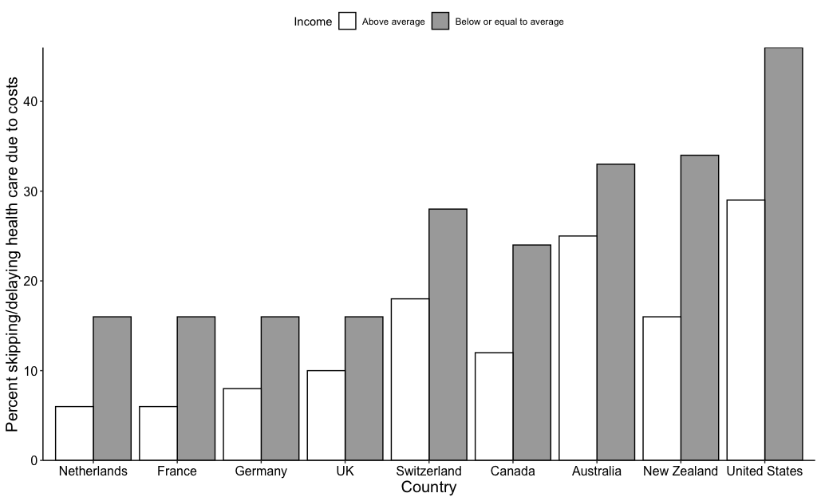
Why is single payer necessary?

Slide 4
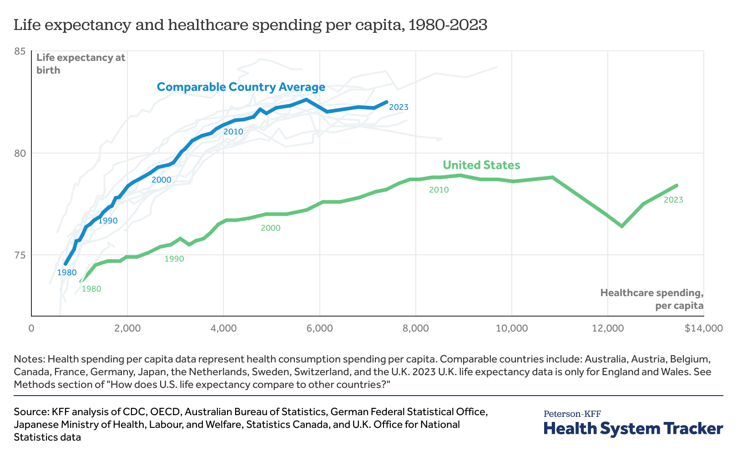
Why is single payer necessary?

Slide 5
Economic analysis
We have conducted an economic analysis of the Trust’s activities to determine
What is required to fund single payer in Massachusetts
Potential savings from implementing single payer
We have also made some projections as to how employees, providers, and businesses will be affected by implementing single-payer, though the focus of the study was on the Trust’s activities.

Slide 6
Economic analysis: main takeaways
Implementing single-payer healthcare in Massachusetts would save about 23% of the Commonwealth’s current health care costs
The bulk of the savings rely on the Commonwealth’s ability to
Negotiate lower prices
Reduce administrative costs
By paying for medical care through taxation instead of premiums/deductibles/copayments, all employees earning less than $500,000 per year would save money.
Hospitals and providers would benefit through price adjustments and decreased provider administration costs.

Slide 7
Overview
The economic analysis has three main parts:
Savings by eliminating unnecessary spending: $54.5 billion
Costs of expanding coverage and ensuring fair prices: $24.7 billion
Tax revenue required to fund single-payer: $46.0 billion
This leaves a $10.4 billion surplus.

Slide 8
(1/3) Savings by eliminating unnecessary spending

Slide 9
(1/3) Savings by eliminating unnecessary spending
MA will spend $125.6 billion on healthcare in 2026
About $9.5 billion (8%) of this goes to administrative costs
Using CMS data for MA, for each source of funds (Medicare/Medicaid/PHI), and each category of spending (e.g., hospital care, physician and clinical services), we projected future expenditures from 2012-2019 expenditures
We estimate insurance administration costs from nationwide rates of “non-coverage spending”
Using CHIA rates of expenditure increase, we get higher estimates of total expenditure
$130.10 billion using the average of rates over the most recent 7 years, and $142.12 billion using the worst-case-scenario most recent (2023-2024) rate of increase of 8.6%
In the absence of recent estimates of PHI-to-Medicare price ratios for hospitals and physicians (the most recent we have uses data from 2020-2022), any estimates using these CHIA rates, which have drastically increased in recent years, will underestimate waste/profits

Slide 10
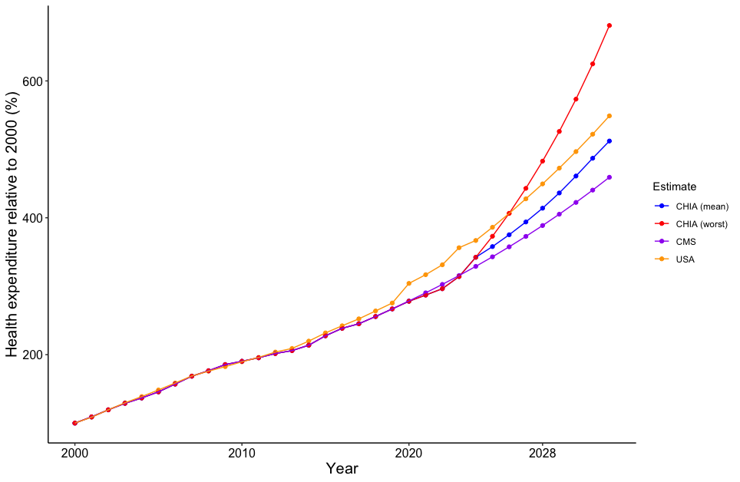
(1/3) Savings by eliminating unnecessary spending
MA will spend $125.6 billion on healthcare in 2026
About $9.5 billion (8%) of this goes to administrative costs

Slide 11
(1/3) Savings by eliminating unnecessary spending
MA will spend $125.6 billion on healthcare in 2026
About $9.5 billion (8%) of this goes to administrative costs
By implementing the Trust, we can save $54.5 billion by lowering prices and eliminating waste

Slide 12
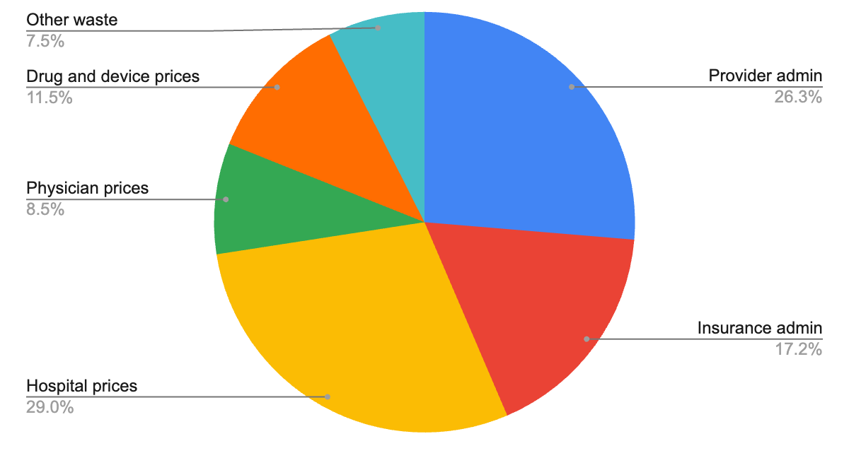
(1/3) Savings by eliminating unnecessary spending
MA will spend $125.6 billion on healthcare in 2026
About $9.5 billion (8%) of this goes to administrative costs
By implementing the Trust, we can save $54.5 billion by lowering prices and eliminating waste

Slide 13
(1/3) Savings by eliminating unnecessary spending
MA will spend $125.6 billion on healthcare in 2026
About $9.5 billion (8%) of this goes to administrative costs
By implementing the Trust, we can save $54.5 billion by lowering prices and eliminating waste
$24.7 billion of the resulting savings will go to expanding coverage and correcting the underpayment of Medicaid services

Slide 14
(1/3) Savings by eliminating unnecessary spending
MA will spend $125.6 billion on healthcare in 2026
About $9.5 billion (8%) of this goes to administrative costs
By implementing the Trust, we can save $54.5 billion by lowering prices and eliminating waste
$24.7 billion of the resulting savings will go to expanding coverage and correcting the underpayment of Medicaid services
$29.8 billion will return to the economy (i.e., can be spent on something other than healthcare)

Slide 15
(1/3) Savings by eliminating unnecessary spending
MA will spend $125.6 billion on healthcare in 2026
About $9.5 billion (8%) of this goes to administrative costs
By implementing the Trust, we can save $54.5 billion by lowering prices and eliminating waste
$24.7 billion of the resulting savings will go to expanding coverage and correcting the underpayment of Medicaid services
$29.8 billion will return to the economy (i.e., can be spent on something other than healthcare)
So, the Trust would spend $98.70 billion in 2026

Slide 16
(1/3) Savings by eliminating unnecessary spending
Savings come from two main areas
Negotiating lower prices
Physician prices (CMS-1500)
Hospital prices (UB-04/CMS-1450)
Drug and medical device prices
Lowering administrative costs
Provider administration
Insurance administration (and eliminating profits)

Slide 17
(1/3) Savings by eliminating unnecessary spending
Price adjustments
Currently, different insurers pay different prices for medical services and products
For example, private health insurance currently pays about 267% of Medicare prices to hospitals, and Medicaid pays about 74% of Medicare prices to hospitals (on average).
Medicaid is cheaper than Medicare, which is cheaper than commercial insurers
But Medicaid (and to a lesser degree Medicare) currently underpays hospitals and providers, which will be corrected under single-payer

Slide 18
(1/3) Savings by eliminating unnecessary spending
Lowering physician prices
Using a 2020 KFF estimate, we assume private health insurance (PHI) prices for physician & clinical services are 143% of Medicare prices
Reducing PHI prices for hospital care to 110% of Medicare prices saves $5.36 billion
Medicaid and Medicare prices will also be increased to 110% of Medicare prices. This is to ensure fair payment.
This adjustment of prices will take place through negotiations conducted by the MHCT, with 110% of Medicare being the target average rate. Some services are currently overpriced by Medicare, and others possibly underpriced.
If the MHCT is only able to negotiate prices down to, for example, 120% of Medicare rates (a 16% reduction instead of a 23% reduction), this would be a loss of about $5 billion.

Slide 19
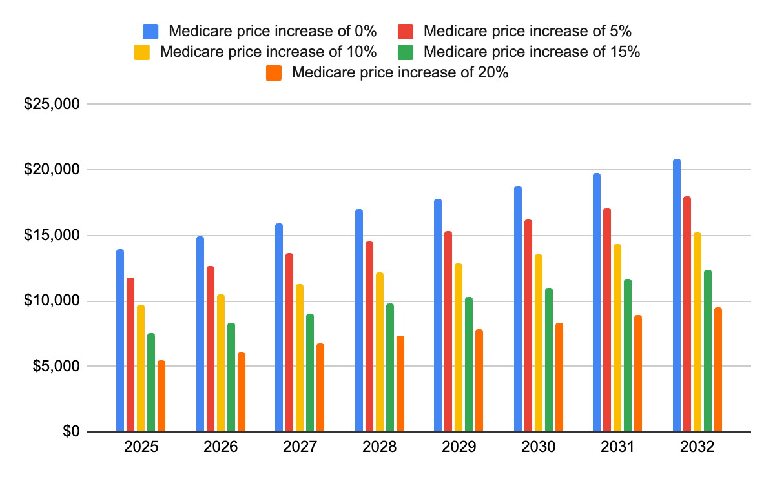
Effect on surplus of alternative Medicare price increases

Slide 20
(1/3) Savings by eliminating unnecessary spending
Lowering hospital prices
Using a RAND estimate from 2022 data, we assume that PHI prices for hospital care are 267% of Medicare prices
Reducing PHI prices for hospital care to 110% of Medicare rates saves $18.47 billion

Slide 21
(1/3) Savings by eliminating unnecessary spending
Lowering drug prices
We assume that PHI pays Medicare part D prices for prescription drugs and durable medical products, which are 291% of Medicaid prices
Reducing PHI and part D prices for drugs to Medicaid rates saves $8.34 billion
This is likely an underestimate of PHI prices, and therefore an underestimate of savings
For context, the VA pays 35% more for drugs than does Medicaid. If the state were only able to negotiate prices down to VA levels (a comparable population of 9 million, vs. the MA population of 7 million), savings would be $6.83 billion

Slide 22
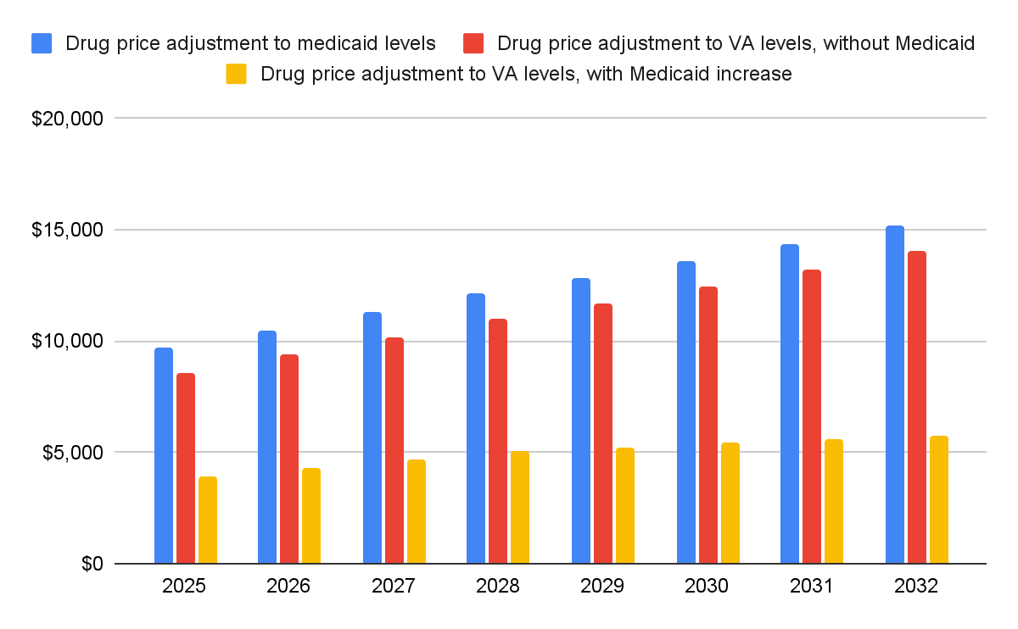
Effect on surplus of alternative drug price reduction schemes

Slide 23
(1/3) Savings by eliminating unnecessary spending
Reducing provider administration costs
We assume that provider administrative costs can be reduced to Canadian levels
We use two different sources that give different estimates of provider administration costs per spending category, but when compared to the Canadian rates both yield about $16 billion in savings

Slide 24
(1/3) Savings by eliminating unnecessary spending
Reducing provider administration costs
We assume that provider administrative costs can be reduced to Canadian levels.
We use two different sources that give different estimates of provider administration costs per spending category, but when compared to the Canadian rates both yield about $16 billion in savings
Category of spending | Admin costs (estimate #1) | Admin costs (estimate #2) | Canadian rates
Hospital Care ($) | 26.6% | 21.0% | 13.1%
Physician & Clinical Services ($) | 21.8% | 27.0% | 17.8%
Other Professional Services ($) | 32.0% | 32.0% | 14.3%
Dental Services ($) | 32.0% | 32.0% | 14.3%
Home Health Care ($) | 39.6% | 32.0% | 13.0%
Nursing Home Care ($) | 26.7% | 32.0% | 16.4%
Other Health, Residential, and Personal Care ($) | 32.0% | 32.0% | 14.3%

Slide 25
(1/3) Savings by eliminating unnecessary spending
Reducing insurance administration costs and eliminating profits
We project that in MA in 2026, 11% of private insurance company expenditure will be on non-coverage expenses (i.e., administration and profits)
Assuming the MA single-payer system can operate with the same medical loss ratio as traditional Medicare (98%), we can reduce administrative rates to 2%
This would yield $10.65 billion in savings

Slide 26
(2/3) Costs of expanding coverage and ensuring fair prices

Slide 27
(2/3) Costs of expanding coverage and ensuring fair prices
These costs come from two main areas
Expanding coverage
To uninsured individuals
Improving coverage for underinsured individuals
Increasing Medicare and Medicaid prices
Both will be increased to 110% of Medicare prices

Slide 28
(2/3) Costs of expanding coverage and ensuring fair prices
Expanding coverage to the uninsured
Expanding coverage to the uninsured population will cost $2.05 billion
The uninsured population in MA has stayed steady at ~2.7% percent since 2015, and we assume it will stay that way
We assume that the uninsured currently spend on healthcare about 22% of what the insured spend, and that (since they tend to be healthier/younger) they will spend 80% of the currently insured once they are insured

Slide 29
(2/3) Costs of expanding coverage and ensuring fair prices
Expanding coverage to the underinsured
Expanding full coverage to the underinsured will cost $10.22 billion
What does it mean to be underinsured?
We use a measurement called actuarial value, which is the percentage of healthcare costs that an insurance plan covers. We estimate the current average actuarial value in MA to be 85.8%.
The MHCT would offer an actuarial value of 96%, meaning that the 4% of healthcare costs that go to unnecessary medical treatments and small out-of-pocket purchases (like aspirin) would not be covered.
Increasing coverage also induces demand. We estimate that increasing actuarial value from 85.8% to 96% will increase utilization by 7.6%.
We estimate the relationship between actuarial value and induced demand using work done for the ACA

Slide 30
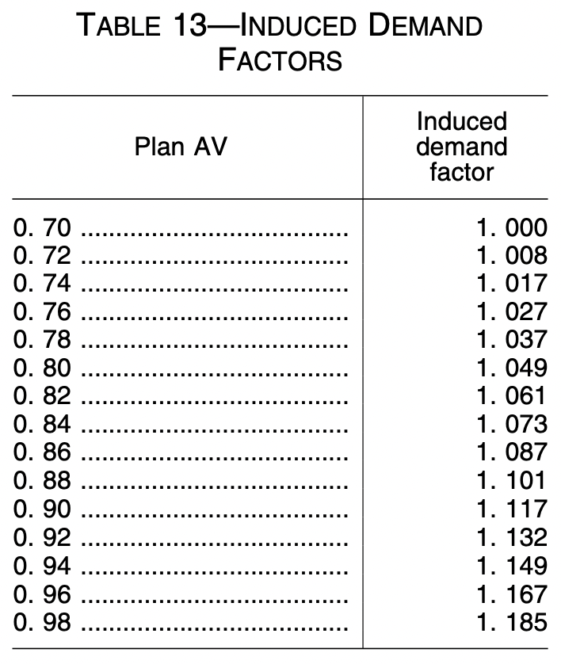
(2/3) Costs of expanding coverage and ensuring fair prices

Slide 31
(2/3) Costs of expanding coverage and ensuring fair prices
Estimation of average actuarial value in Massachusetts
Coverage type | Actuarial value | Proportion of population | Weighted AV
Employer | 84.20% | 52.2% | 44.0%
Nongroup | 70.00% | 5.5% | 3.9%
Medicaid | 100.00% | 25.6% | 25.6%
Medicare | 83.70% | 14.3% | 12.0%
Military | 90.00% | 0.4% | 0.4%
Uninsured | 0.00% | 1.9% | 0.0%
Total |  |  | 85.8%

Slide 32
(2/3) Costs of expanding coverage and ensuring fair prices
Adjusting Medicare and Medicaid prices
We assume that the Commonwealth can negotiate hospital and physician prices to, on average, 110% of Medicare levels
We also raise Medicaid prices, which reportedly underpay hospitals and physicians, to 110% of Medicare levels, which costs $10.9 billion
Not considering Medicaid increases or the loss of reduction in PHI prices, the increase in Medicare prices by 10% otherwise costs $1.9 billion
Note that community health centers and other providers that rely most heavily on Medicare/Medicaid and least heavily on private health insurance benefit from this arrangement, since private prices are decreased and Medicare/Medicaid prices increased

Slide 33
How will price adjustments impact hospitals/providers?
So, physicians and hospitals and other institutions providing health care will on aggregate
Lose $18.47 billion + $5.36 billion = $23.83 billion due to PHI price reductions
Gain $10.9 billion + $1.9 billion = $12.8 billion due to Medicare and Medicaid price increases
Gain $14.35 billion from reducing provider administration costs
On aggregate, $12.8 billion + $14.35 billion - $23.83 billion = $3.32 billion in additional revenue will go to hospitals/health centers and physicians

Slide 34
How will price adjustments impact hospitals/providers?
But, that is on aggregate. Not every provider will be impacted equally.
Community health centers and other providers that rely most heavily on Medicare/Medicaid and least heavily on private health insurance benefit from this arrangement, since private prices are decreased and Medicare/Medicaid prices increased
Changes in health center/hospital revenue depend primarily on payer mix, and the degree to which the state is able to streamline provider administration
Time otherwise spent on administration can be put towards medical care, meeting the new induced demand

Slide 35
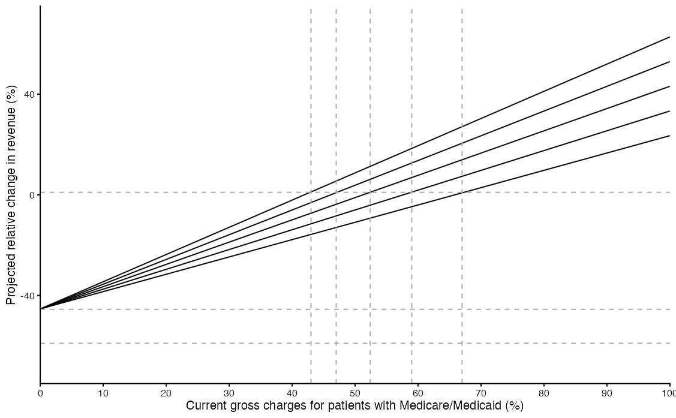
How will price adjustments impact hospitals/providers?
Only non-grant revenue is considered for FQHCs
Mix between public payers
100% Medicaid
75%
50%
25%
FQHCs
0%
BSMC
BIDMC
BWH
MGH
Vertical lines indicate payer mix required to break even given Medicare-to-Medicaid ratio
+13.5% savings from reducing provider administration costs

Slide 36
Effect on surplus of alternative Medicare price increases

Slide 37
(3/3) Tax revenue required to fund single payer

Slide 38
(3/3) Tax revenue required to fund single payer
The Trust would need to fund $98.70 billion in expenditures in 2026
We have $63.09 billion in existing revenue
Through five taxes (each with a $20,000 exemption), the Trust can raise $46.01 billion in new revenue
7.5% payroll tax on small employers ($9.31 billion)
8% payroll tax on large employers ($18.40 billion)
2.5% income tax on employees ($7.47 billion)
10% income tax on self-employed ($1.84 billion)
10% on non-payroll income ($9.01 billion)
This includes capital gains, dividends, interest, and S-Corp income
This leaves the Trust with a $10.4 billion surplus in 2026

Slide 39
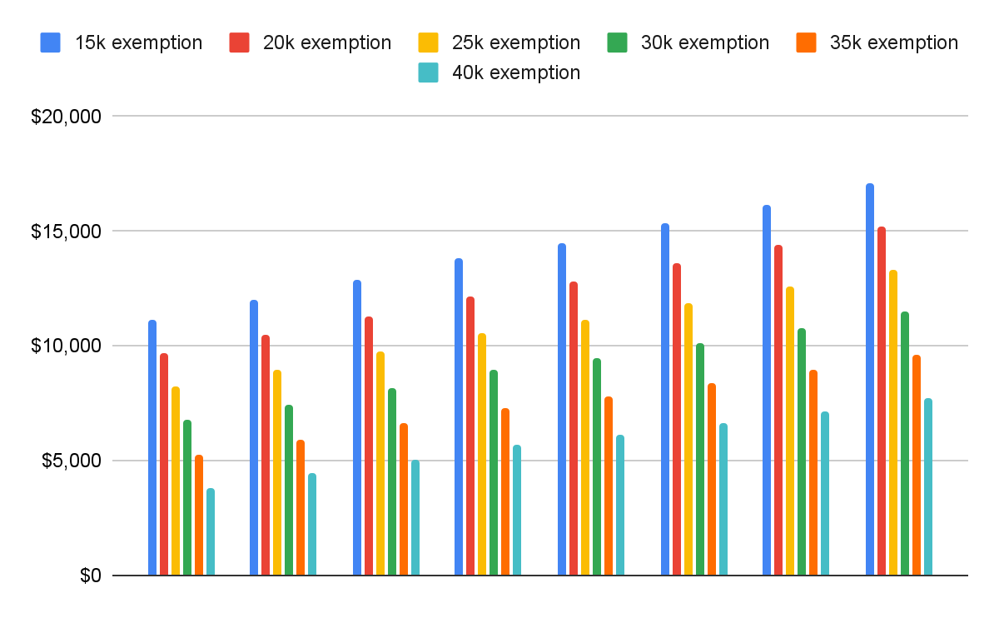
Effect on surplus of alternative tax exemptions
2025
2026
2027
2028
2029
2030
2031
2032

Slide 40
Existing revenue
(3/3) Tax revenue required to fund single payer

Slide 41
Existing revenue
(3/3) Tax revenue required to fund single payer
We assume we are able to continue receiving current levels of federal funds, but do not assume that the federal government will cover its usual share (50%) of the increase in Medicaid prices

Slide 42
Existing revenue
(3/3) Tax revenue required to fund single payer
We assume we are able to continue receiving current levels of federal funds, but do not assume that the federal government will cover its usual share (50%) of the increase in Medicaid prices
Source of revenue
Medicare | $26,084
Medicaid | $22,233
Other state public health | $9,529
Remaining out-of-pocket | $3,948
ACA subsidies | $1,298
Total | $63,092

Slide 43
Existing revenue
(3/3) Tax revenue required to fund single payer
We assume we are able to continue receiving current levels of federal funds, but do not assume that the federal government will cover its usual share (50%) of the increase in Medicaid prices
OB3 cuts take away about $3.5 billion of existing revenue, which is not accounted for in the report
Source of revenue
Medicare | $26,084
Medicaid | $22,233
Other state public health | $9,529
Remaining out-of-pocket | $3,948
ACA subsidies | $1,298
Total | $63,092

Slide 44
Existing revenue
(3/3) Tax revenue required to fund single payer
We assume we are able to continue receiving current levels of federal funds, but do not assume that the federal government will cover its usual share (50%) of the increase in Medicaid prices
OB3 cuts take away about $3.5 billion of existing revenue, which is not accounted for in the report
To account for the impact of OB3, just subtract $3.5 billion from the $10.4 billion surplus (giving a $6.9 billion surplus)
Remaining out-of-pocket may dwindle over time
Source of revenue
Medicare | $26,084
Medicaid | $22,233
Other state public health | $9,529
Remaining out-of-pocket | $3,948
ACA subsidies | $1,298
Total | $63,092

Slide 45
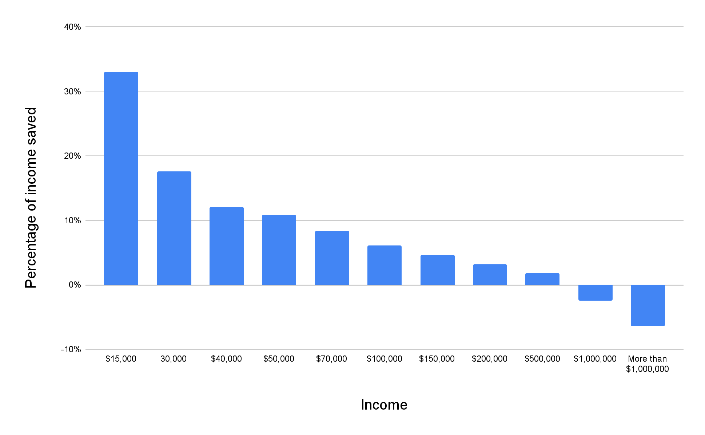
Percentage of income saved that would otherwise be spent on healthcare by income group (after MHCT taxes)

Slide 46
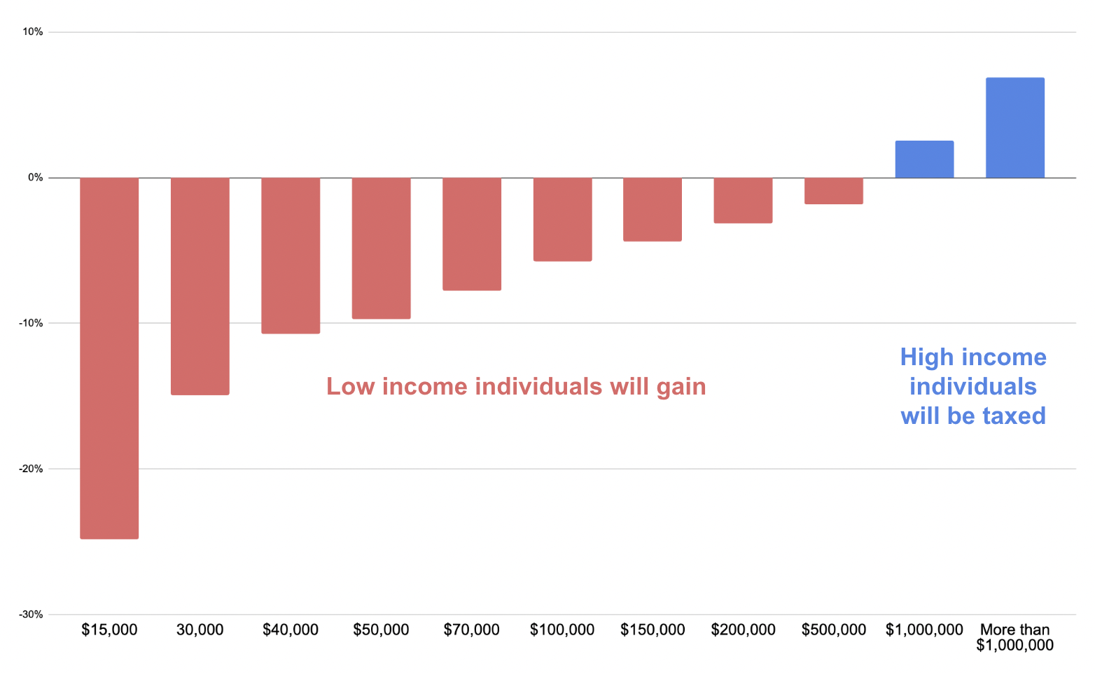
Another way of looking at it is that currently, low income individuals are paying much more for healthcare than is necessary

Slide 47
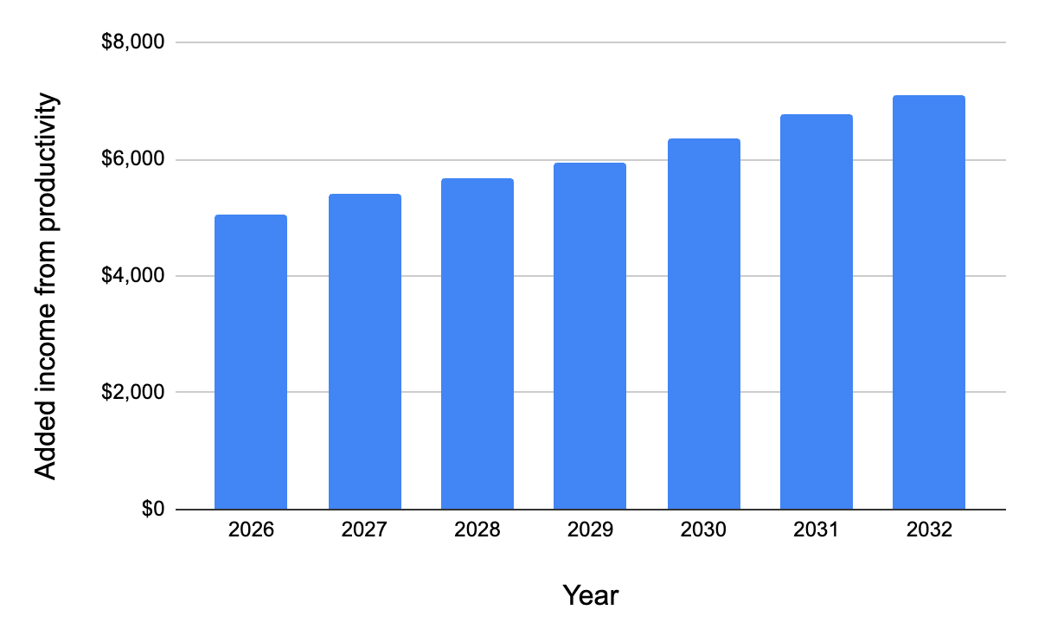
We also anticipate added income from improved health, plus macroeconomic feedback effects

Slide 48
Under the current system, total expenditures in 2026 would be $125.6 billion
Switching to single-payer and eliminating unnecessary spending would save $54.5 billion
Expanding coverage and increasing Medicare/Medicaid prices would cost $24.7 billion
With $63.09 billion of existing revenue and $46.01 billion of new tax revenue, we would have a $10.4 billion surplus in 2026. The surplus is projected to increase in future years.
Summary

Slide 49
Thank you!

